Slide 1

Starting Primary One
Guidance for Parents
Children and Young People’s Services
SEND Implementation Team
Notes:
*Welcome parents and introduce yourself and your role as the SENCo of the school.*
-Today I want to discuss the transition process for pupils entering primary one and explain how important it is that this is managed effectively by everyone involved with your child.
-We will also discuss your role as a parent during this process and how important it is that we work together in partnership during this crucial time in your child’s education.
- We will look at the main changes that your child will have to adapt to as they begin Primary education, how they may feel about these changes and what measures the school already has in place to support them in this process.
-We will discuss the importance of sharing information with the school about your child to allow us to prepare and be ready to meet their needs in Primary One.
-Finally, we will look at the ways in which the school meets the needs of all its individual learners though a wide range of resources, strategies and teaching styles and what you should do if you are concerned about an aspect of your child’s learning.

Slide 2

Starting School
When a child moves into Primary One they have to learn to cope with many changes. Do not worry if their skills seem to go backwards at first, this is quite normal as it is a big change for them. Acknowledge your child’s feelings and reassure them that they will soon get used to their new school. Stories and pictures about starting school can be helpful.
Environmental differences in:
Room, size and layout
Lighting and furniture
Equipment and resources
Toilets, cloakroom, play and eating areas
Social differences in:
School rules/expectations
Language and vocabulary
Relationships with others
Structure to the day
Increased number of verbal instructions
Notes:
-Some children will find the transition process exciting and will happily adapt to the changes with very little support required.
- Other children will experience greater issues and will need support from school and home to help them manage this stage in their education smoothly.
- Every child is individual and will need to be allowed the time to adapt to these changes at their own pace.
-Please feel assured that the school is very aware of the issues that children may experience when beginning Primary One and has lots of strategies and activities which will help your child become accustomed to their new environment.

Slide 3

Children may feel:
Sad
Confused
Worried
Uncertain
Anxious
Overwhelmed
Hopeful
Insecure
Excited
Moving into Primary One can be a source of both excitement and anxiety for children and their parents. Throughout the transition process, young children need to feel secure and confident that their needs, wants, likes and dislikes will be understood.
Careful planning, preparation and collaboration between everyone involved should ensure that your child will transition smoothly and happily into their Primary One year in school.
Notes:
-All children will transition into primary one with a different range of feelings and experiences.
-As a parent, it is important that you reassure your child by talking lots to them, in a positive way, about school and the types of activities they will be doing there.
-Prepare your child for the early weeks in school by making sure they are well rested each night, setting good routines for getting ready for school in the morning and making sure that they have everything they need for school so that they leave home calm and relaxed each morning.
-Establishing good routines and encouraging a positive attitude in your child towards school from the outset will help them feel supported and secure.

Slide 4

The role of parents
Parental involvement in supporting your child in school is vitally important.
Creating positive partnerships with school staff at an early age will help your child to feel safe and achieve his or her full potential.
It is important to remember that we are all working together to get the best for the children.
Sharing key information about your child with the school is essential in order that their needs can be met effectively.
Clear communication and a consistent approach between home and school will help support children through transition.
Notes:
-Your role as a parent is vitally important to us within the school. You possess unique information about your child that may be usefully shared with the school in order that we can prepare and plan effectively for them coming to school.
-It is important that we work together in partnership to support your child and that we communicate openly as your child begins their educational journey at our school.
-If information about your child’s needs is communicated to us it will be treated with the utmost respect and confidentiality. The more detailed a picture we have built up about your child’s needs, strengths, weaknesses, likes and dislikes before they start Primary One the more prepared we can be and the smoother your child’s transition into Primary one will be.

Slide 5

The voice of the child
Young children depend on the adults around them to share important information about them that will allow their needs to be fully met.
Children have a unique view of their needs and capabilities and should be helped to express their opinions about matters that affect them in school.
The school will ensure that your child will be listened to and that their views will be valued.
Notes:
(largely self-explanatory)
-In school we encourage the children from a young age to have a say in things that affect them. Pupil voice is the right for children to:
express opinions;
participate in making decisions regarding all aspects of their life such as education; and
receive support to express themselves from those who can influence decisions.

Slide 6

Measures in school to help your child transition smoothly may include:
Visits by the Primary One teacher to the pre-school setting to meet children and discuss individual pupils.
The school “buddy system” between the pre-school and Primary Six pupils.
Pre-school pupils coming to visit the school during “stay and play” sessions.
Sharing of information between
parents, pre-school staff and the
Primary One teacher.
Notes:
*NB: The above are examples only. Amend or add to this list according to the types of measures that your school uses to support children entering primary one.
-Discuss some examples of transition practices in your school and say how they benefit the children as they transition from the pre-school.

Slide 7

Telling us about your child
Sharing information about your child is very helpful to the school in building up a picture of them so that their needs can be met and supported.
Information about your child may include:
Likes and dislikes
Favourite things
Fears
Sensory issues
Communication level
Independent self-management skills
Social Skills
Any other information that you feel the school needs to know in order to plan for your child coming into Primary One.
All information shared will be treated confidentially by the school
Notes:
(Have an information gathering booklet for each parent photocopied which they take home to complete about their child following today’s talk- e.g: use the “All About Me” EA Early Years booklet).
-As a school, we would like to be well prepared to meet the individual needs of your child in advance of them beginning school in September. We would like you to complete a booklet of information that tells us about your child and return it to the school before the end of June.
-The booklet about your child helps us to gather information so that we have a sense of their likes and dislikes, strengths and weaknesses and any issues regarding their needs that you as a parent feel we should know about before they start primary one.
**Spend a few minutes going through the information gathering booklet.
-It is important that you fill in the sections of the booklet as honestly and clearly as possible about your child so that staff can make any necessary preparations for your child coming to school in September.

Slide 8
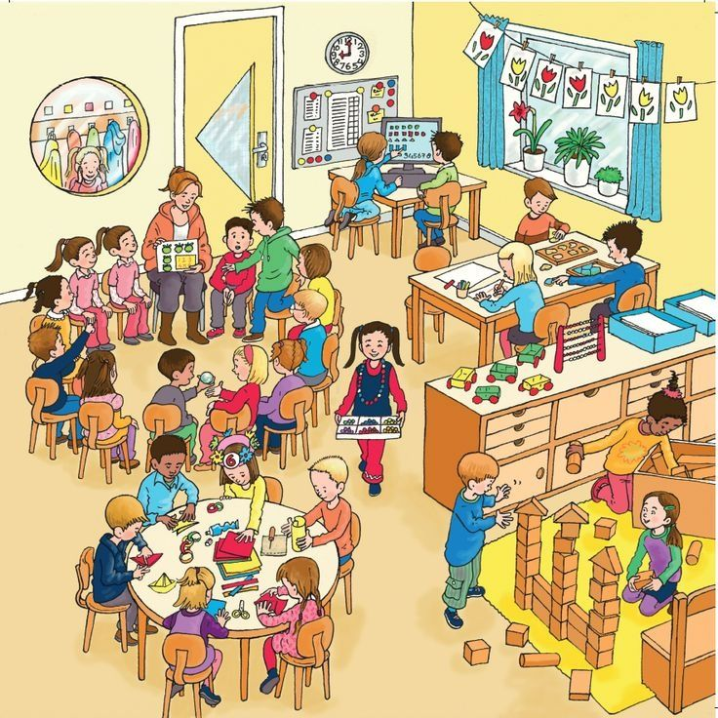
Meeting the needs of all learners in school
Children have different skills, abilities and interests, they make progress at different rates and have different ways in which they learn best. Praise your child for trying their best and don’t compare them with others, this will build their confidence.
If your child is provided with different work or activities in class from that of their classmates, you should not be worried. All children are different and teachers are highly skilled at using a wide range of approaches and strategies to help children learn.
Teachers look carefully at how they organise
lessons, the classroom, the materials and
activities they give to each child and the way
they teach. This is often called differentiating
the curriculum.
Notes:
HIGHLIGHT:
-Children are all individual and bring a diverse range of needs and experiences to the classroom.
-Teachers are highly skilled at amending their teaching approaches and resources to meet the needs of the full range of learners in their classrooms. They do this instinctively as part of their everyday teaching.
-A wide range of differentiation, modified resources, questioning approaches, etc, that appeal to different learning styles and rates are used by teachers on a daily basis to ensure that all children are being fully engaged in the learning process.
-Do not assume that your child has Special Educational Needs simply because they may be being offered slightly different activities than their peers. This is just an indication that your child’s class teacher is aware of the individual needs of everyone in the classroom and is catering for these in a range of different ways.

Slide 9
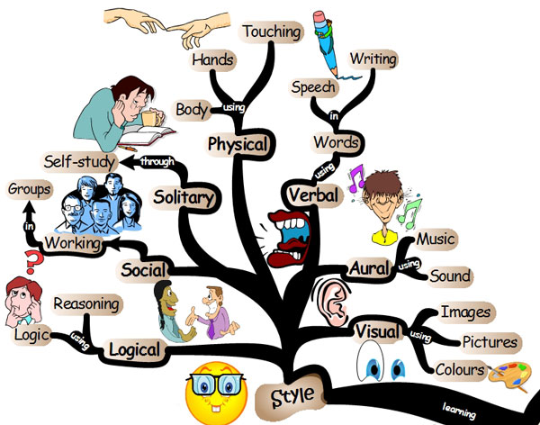
What our school does to support individual differences between learners
Lots of children will have learning difficulties from time to time and the school is well organised to address this by:-
Grouping the children for learning new tasks
Using different learning materials and resources
ICT
Over learning in the classroom
Small group withdrawal
Use of practical resources
Providing some small “catch up groups” for literacy and numeracy
Providing training for teachers
Most children with learning difficulties do not have Special
Educational Needs
Notes:
**Add or amend this list according to the range of ways that your school supports learners generically**
Use the list to expand on the previous slide as examples of how teachers meet the needs of all learners as part of their everyday teaching..

Slide 10

What is meant by Special Educational Needs (SEN)?
In the 1996 Education Order a child is described as having special educational needs (SEN) if they have significantly greater difficulty in learning than the other children, that calls for special educational provision to be made. A child also has SEN if they have a disability that calls for special education provision that is additional to or otherwise different from what the other children of a similar age receive in an ordinary school.
If your child’s school thinks that your child needs special educational provision they will be placed on the school’s SEN Register and the school Special Needs Co-ordinator (SENCo) will oversee their special educational provision and monitor their progress on an individual education plan (IEP).
Only the school can decide if your child should be placed on the SEN register.
The school will meet with you to discuss your child’s needs and agree the targets for their Individual Education Plan (IEP) and what you can do to help address their learning needs.
Notes:
The school has very clearly defined processes for deciding whether a child has special educational needs which require additional provision to be made for them.
-Lots of interventions, differentiation and reasonable adjustments will be put into place by class teachers before the school considers placing a child on the SEN register. It is only when the school feels that these interventions and adjustments are not working, the child is not progressing or is not happy, and when they now feel that further action needs to be taken to meet their needs, that additional provision will be made and the child’s name placed on the SEN register.
-Deciding to put a child on the SEN register is a serious consideration for a school and a significant amount of thought, investigation and discussion is part of this process.
-The school will keep you aware of any concerns they have about your child’s learning needs and will discuss any proposed provision with you in advance.

Slide 11

What to do if you are concerned that your child may have Special Educational Needs
As your child moves through school their progress will be monitored and their teachers will build up a picture of their interests, skills and abilities.
The teachers in school are well trained to address learning needs and difficulties. The teacher will contact you if your child is not making the progress that they would expect.
Many children experience difficulties with their learning from time to time but only a small number have Special Educational Needs (SEN).
If you are worried about your child’s progress, contact the class
teacher who will arrange a time to meet with you. The teacher
will explain how your child is getting on in school and, if needed,
will address any concerns you may have. They will also advise you
on how you can help your child at home.
Notes:
Highlight:
-If you have a concern about how your child is getting on at school, speak to your child’s class teacher.
-The teacher will discuss how your child is progressing and how the school and home can work together to best meet your child’s needs.
-Many children will experience issues with aspects of their learning as they move through the school but the majority of these issues are dealt with through good quality teaching approaches and are not Special Educational Needs.
-The school welcomes the important contribution that parents make to their child’s education and will always listen to and take your concerns seriously.

Slide 12

Getting ready to learn!
Give Your Child a Helping Hand
(DE & HSCT)
Help prepare your child for learning (suitable for children aged 0-4)
Top Tips booklet for Parents
Notes:
**Give out copies of this document to parents to take home or inform them where they can access a copy of it (DE website)
-This is al booklet for all parents which provides advice in each section, across a wide range of child development areas. Suggestions are included on ways in which parents can help their child’s learning and development in the early years, e.g: advice on talking and listening with your child, playing with your child, reading with your child, encouraging positive behaviour, sensible use of electronic devices, etc.
-Reinforce the message to parents that their role in preparing their child to begin primary one is vitally important and this booklet gives very good advice and guidance on things that they can do with their child at home to support the school’s work.

